Slide 1
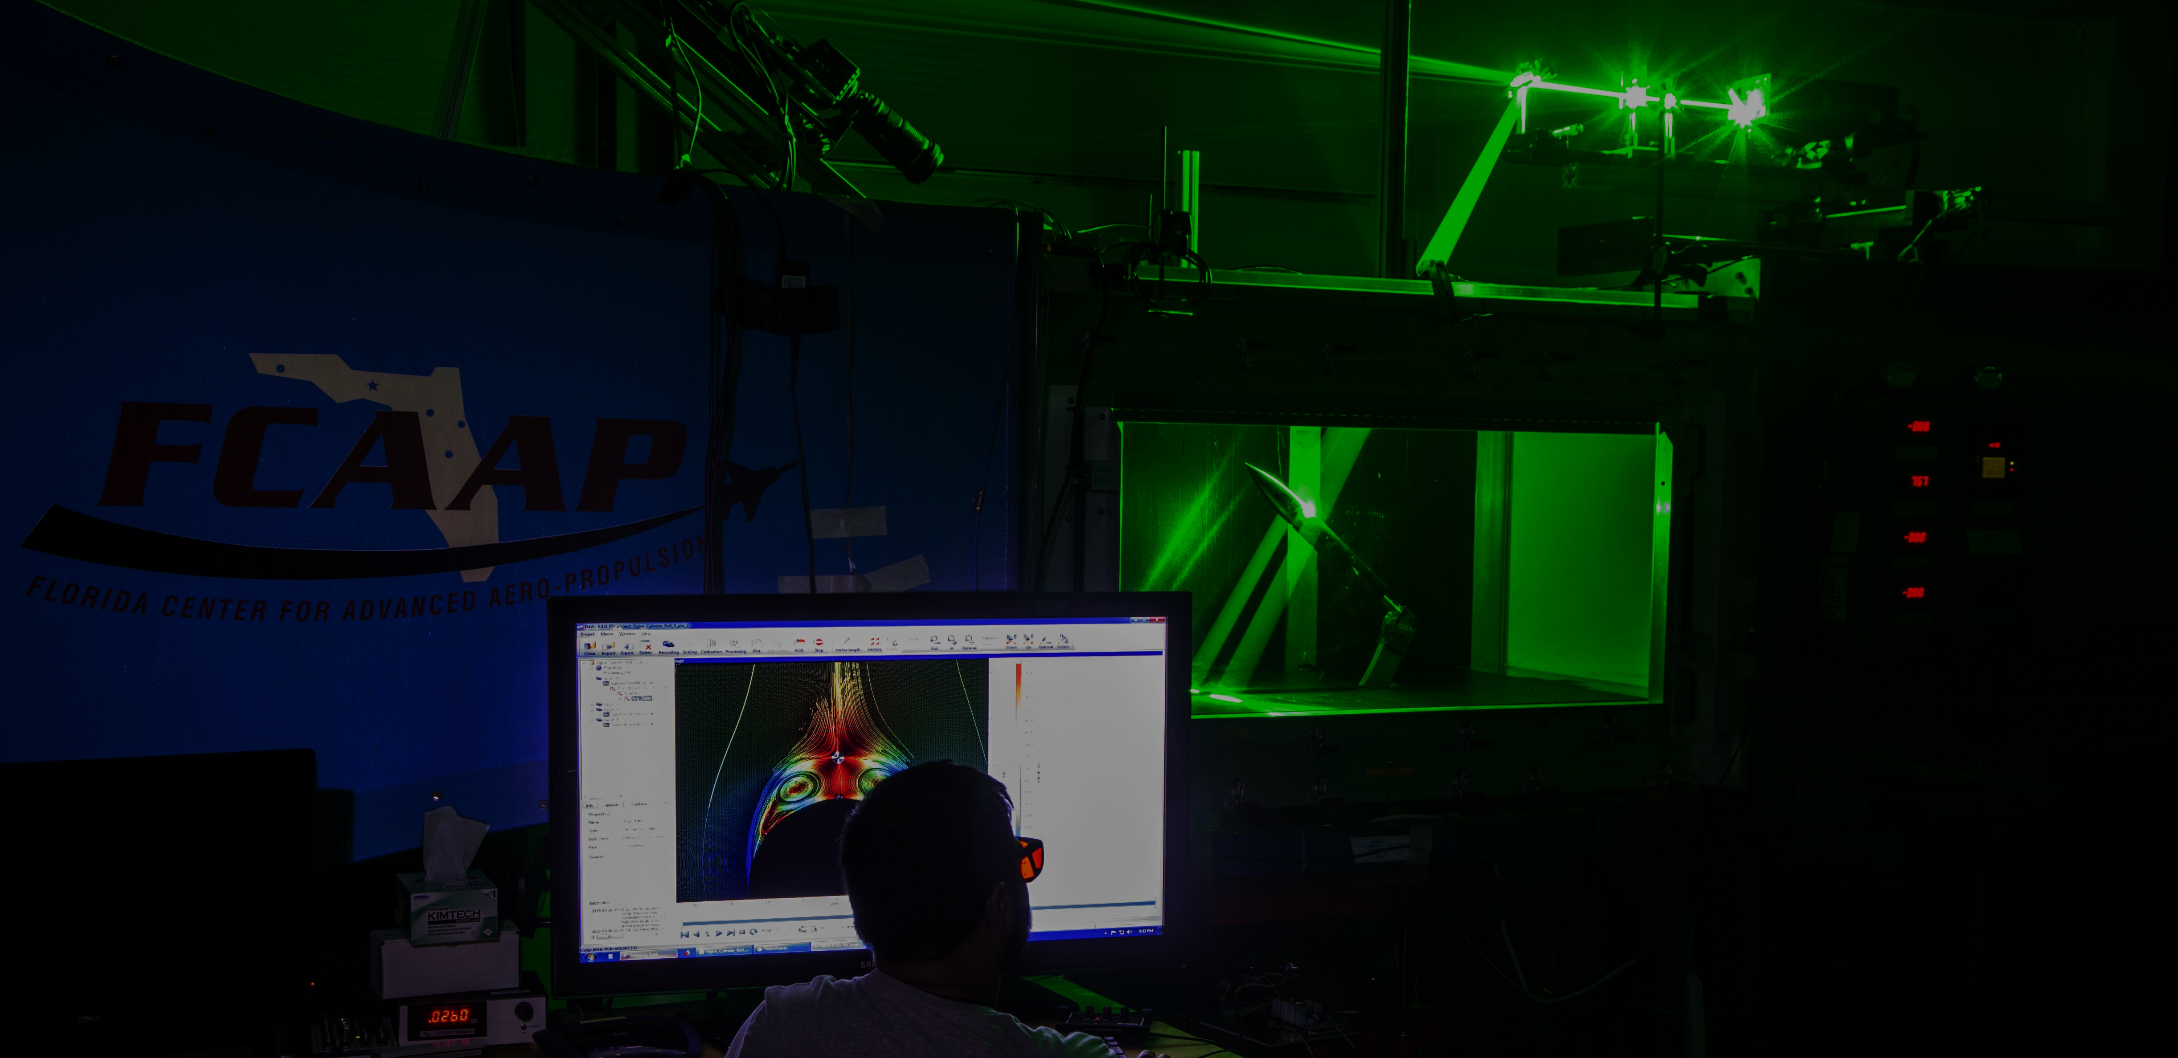
Smart Projectile
Jack Corbin | Prosley Dorcely | Emily Groth
Deepkumar Patel | Aaron Weingarten

Slide 2





Team 509
Jack Corbin
Fin Engineer
Prosley Dorcely
Hardware Engineer
Emily Groth
Assembly Engineer
Deepkumar Patel
Design Engineer
Aaron Weingarten
Systems Engineer
Deepkumar Patel

Slide 3
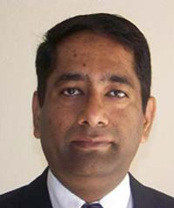
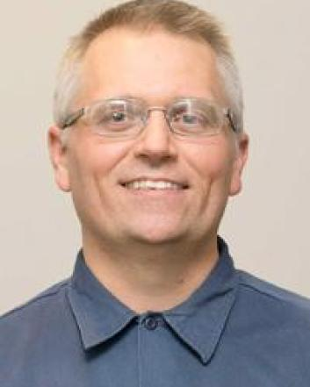
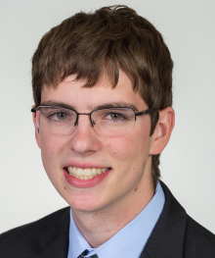

Sponsor and Advisor
Dr. Rajan Kumar
Sponsor
Dr. Jonas Gustavsson
Advisor
Robert Smith
Advisor
Deepkumar Patel

Slide 4
Objective
The objective of the project is to create a scale model of a projectile with an articulating nose cone and deflectable fins for subsonic wind tunnel testing.
Deepkumar Patel
Deepkumar Patel

Slide 5
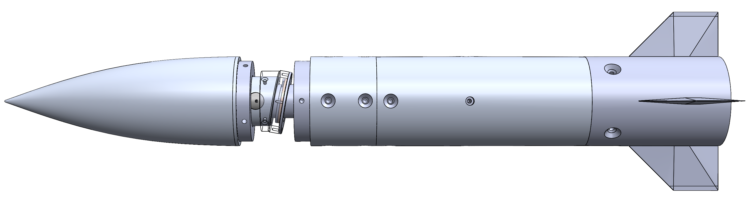
FCAAP Existing Model
Previous project just dealt with nose deflection.
Fins are not deflectable​
​
Excess current lead to overheating and reduced test time​
Excess weight caused sagging
Vibration from articulation mechanism​
Deepkumar Patel

Slide 6
Critical Targets and Metrics
Nose deflection between 0 to 5 degrees with resolution ±0.1
Dynamic deflectable fins between 0 to 30 degrees
Time constant optimized to less than 0.5 seconds
θ
Deepkumar Patel

Slide 7
Assumptions
Assumption 1
Assumption 2
Gravitational force will be far greater than the aerodynamic forces.
Assumption 3
No shockwaves will be produced (subsonic and incompressible)
Model has access to an outside power supply and controls.
Deepkumar Patel

Slide 8
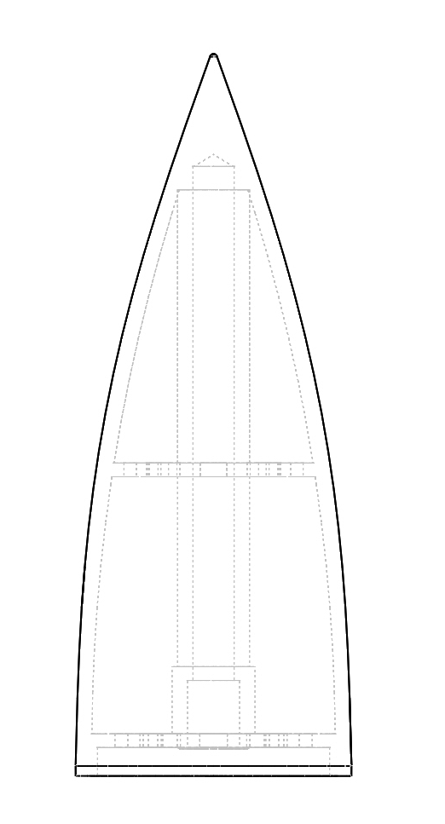
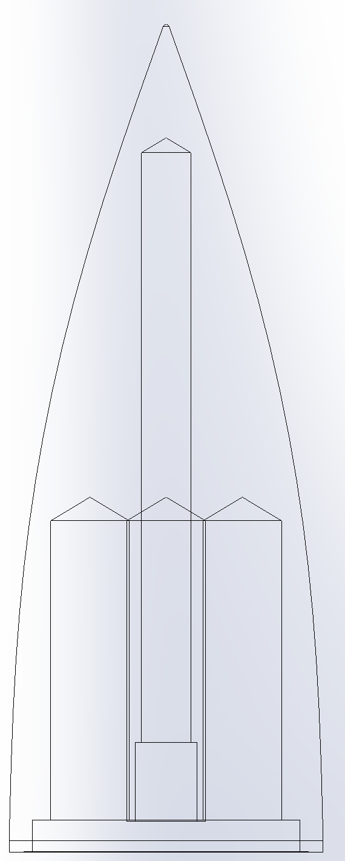
Nose Cone Light Weighting
Sintering Light Weight Model:
Weight: 148g
Complex geometries require a method of additive manufacturing
Original Model:
Weight: 270g
Simple light weighting can be machined in house
Deepkumar Patel

Slide 9
Motor Housing
Inner diameter of outer body is 1.8 inches
The motors must fit between the support shaft and the inner wall of the outer body
Requirements:
5 grams or less
Under 0.65 in Diameter
Diameter of support shaft is 0.5 inches
Jack Corbin

Slide 10
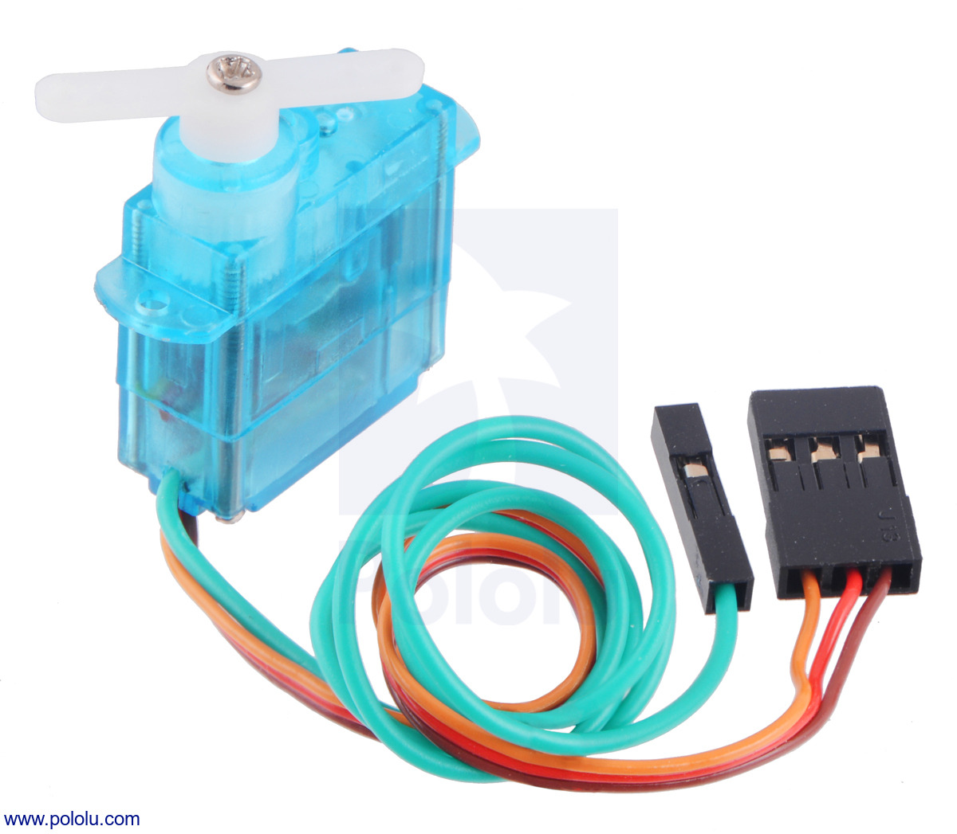
Motor Selection
FEETECH Sub-Micro Servo FS0403-FB
Specially modified to provide access to the feedback potentiometer through a fourth (green) wire, allowing you to directly measure the position of the output.
Specs:
5 Grams
0.79 x 0.76 x 0.33 in
Positional Feed back
Jack Corbin

Slide 11
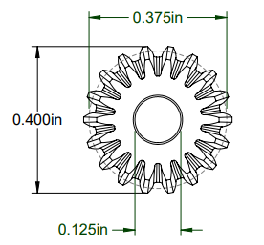
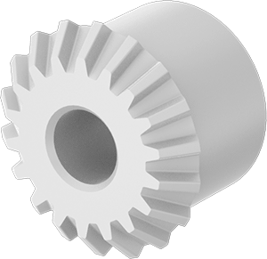
Gear Selection
Plastic Miter Gears
18 teeth
Nylon plastic
Gear pitch: 48
Jack Corbin

Slide 12
Fin Attachment
Method 1
Weld a large short shaft to end of fin
Brittle connection
Possible manufacturing problem when cleaning up connection surface
Method 2
Drill hole in each fin and insert a smaller shaft inside
Might be weaker and compromise the fin
Shaft would fail from bending
Jack Corbin

Slide 13
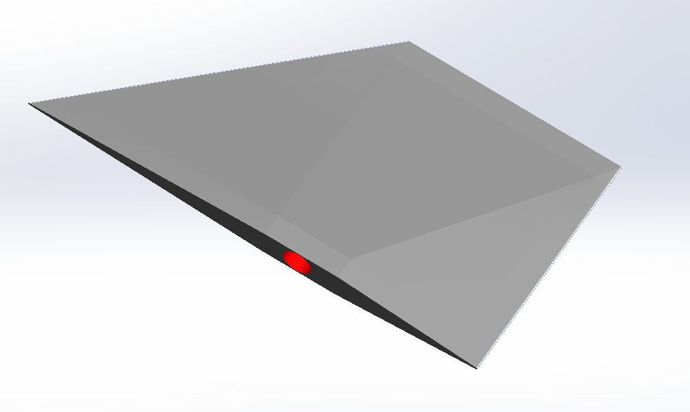
Fin Attachment
Fins
Hole is drilled....
Attachment
Back Body
Jack Corbin

Slide 14
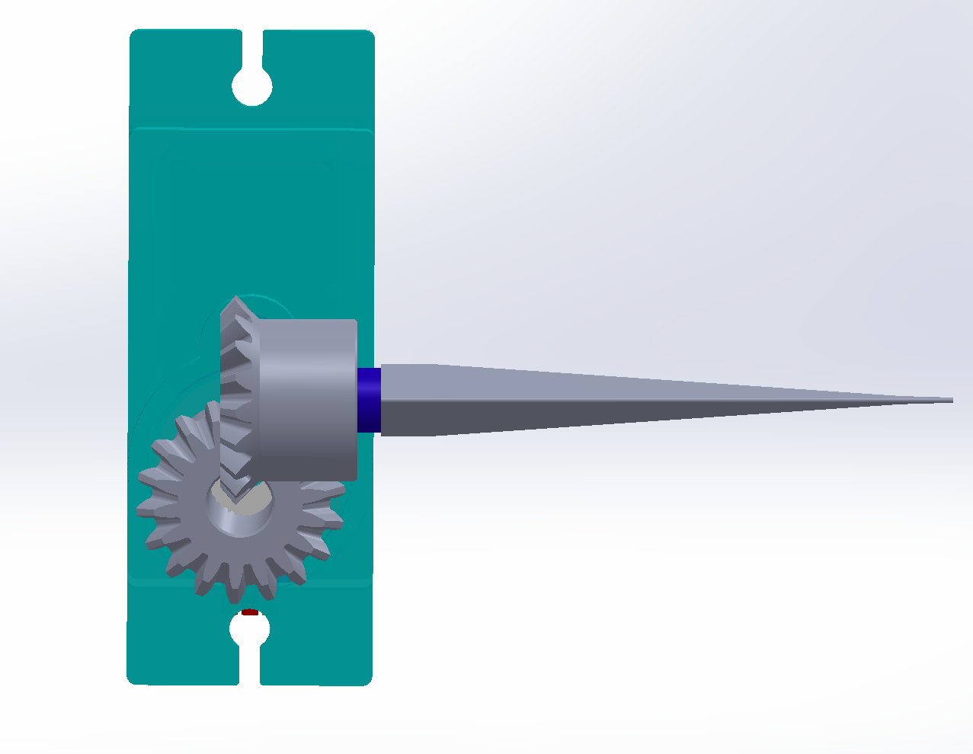
Gear Connections
Fins
Shaft connects gears to Servo
Attachment
Back Body
Jack Corbin

Slide 15
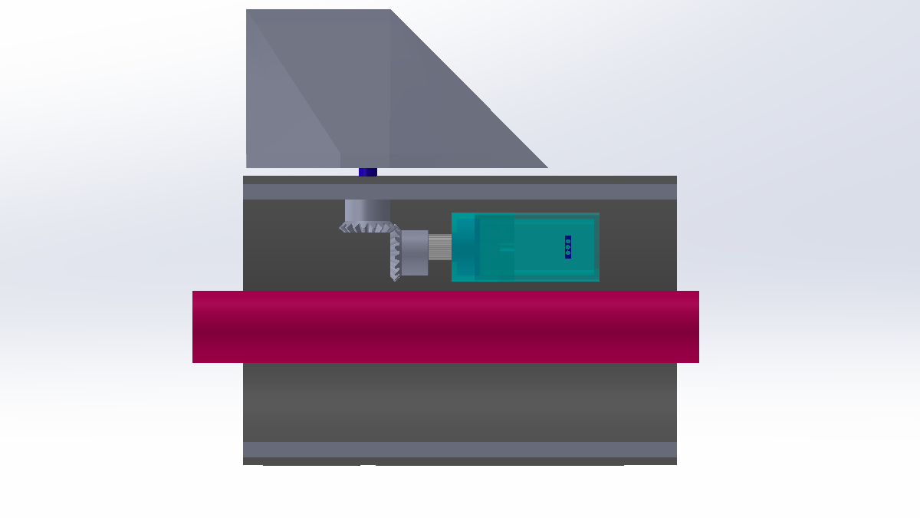
Fin Assembly
Fins
Hole is drilled....
Attachment
Back Body
Jack Corbin

Slide 16
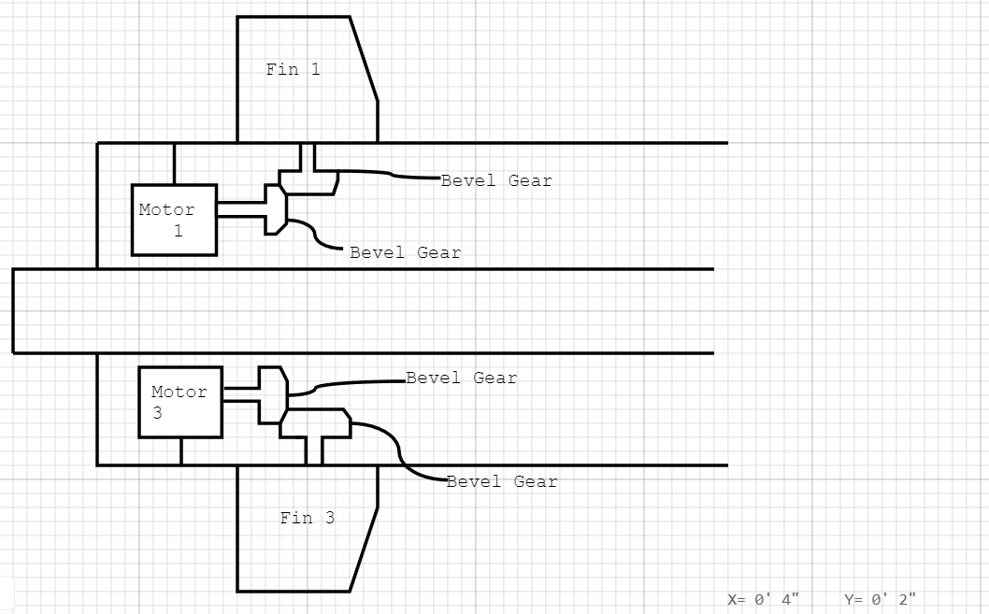
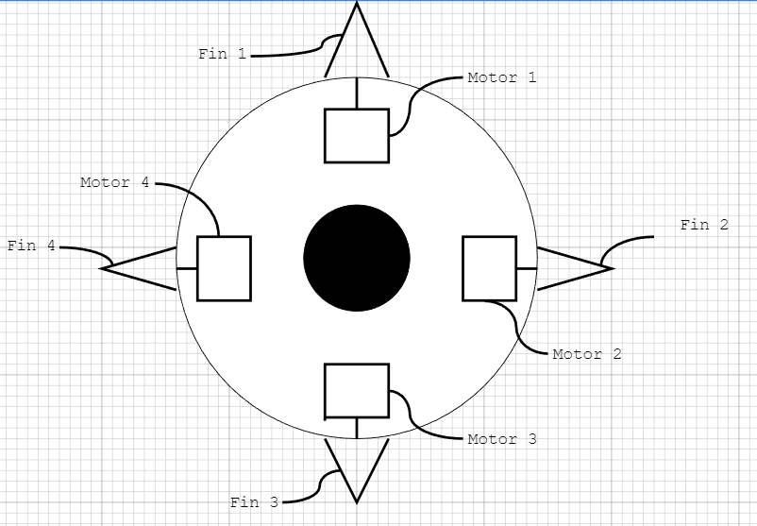
Fin Motor Configuration
Right Side View
Back View
Prosley Dorcely
Prosley Dorcely

Slide 17
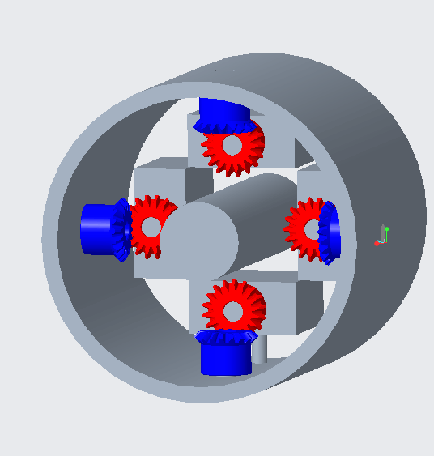
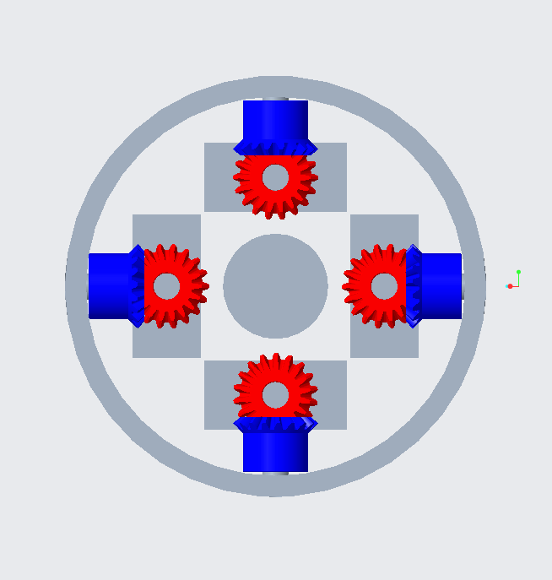
Motor Configuration
CAD model for the motors and gears configuration
Angled View
Back View
Prosley Dorcely

Slide 18
Parts that Need to be Machined Again
Back fin body
Frontal Motor Mount
Frontal Deflecting Surface
Rear Deflecting Surface
Mounting Hub
Prosley Dorcely

Slide 19
Budget
Item​ | Price​
6 FEETECH sub-micro servo FS0307​ | $39.00​
2 FEETECH sub-micro servo fs0403-fb with position feedback​ | $20.50​
10 plastic miter gears​ | $79.90​
Xometry​ for the Nose Cone | $1000.00​
Budget | $2000.00
Spent | $1138.90
Left | $861.10
Prosley Dorcely

Slide 20




Next Steps
Machining
April
Final Testing
Senior Design Day
Celebration
Assembly
March
Testing
Update Code
Prosley Dorcely

Slide 21
Thanks for listening
Jack
Corbin
Deepkumar Patel
Emily
Groth
Prosley Dorcely
Aaron
Weingarten
Prosley Dorcely

Slide 22
Markets and Stakeholders
FCAAP
Air Force
Boeing
Raytheon
Lockheed Martin
General Dynamics
College of Engineering
Dr. Jonas Gustavsson
Dr. Rajan Kumar
Dr. Shayne McConomy
Dr. Suvranu De
Emily Groth

Slide 23
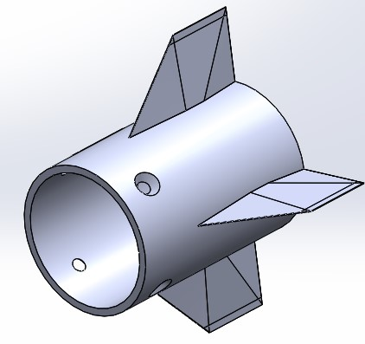
Fin Deflection
Implement four small motors to control each individual fin
Lack of space in the rear portion of the model
Need to find motors that are small enough to fit in body and have high precision
Aaron Weingarten

Slide 24
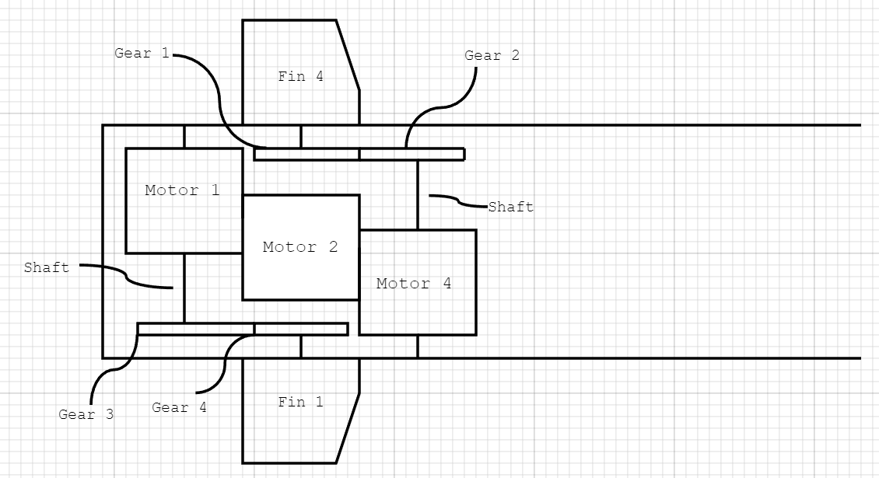
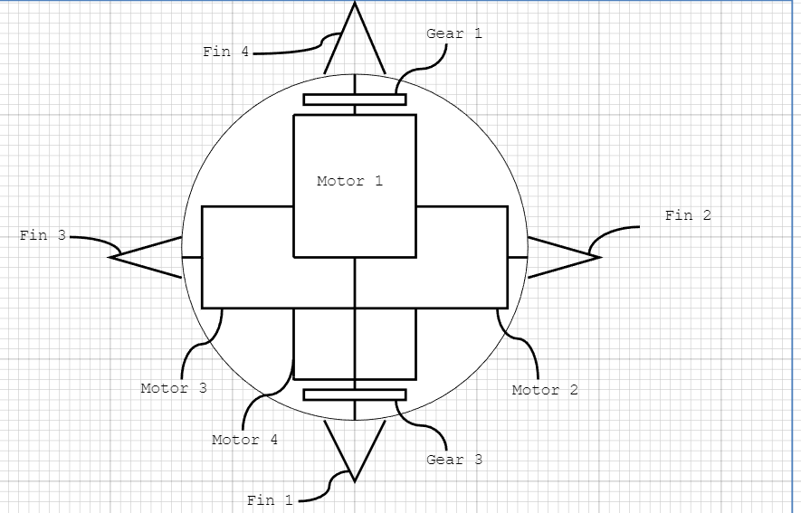
Fin Motor Configuration 1 (Update with new CAD)
Right Side View
Back View
Prosley Dorcely

Slide 25
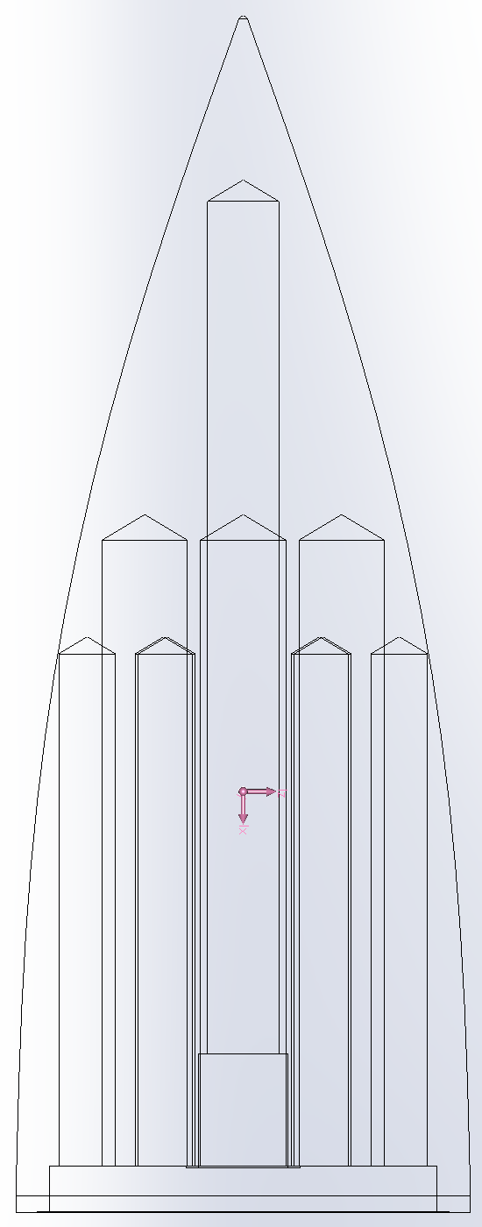
Nose Cone Light Weighting (Update on Sintering?)
Original Model:
Weight: 270g
Simple light weighting can be machined in house
Alternative Drilling Model:
Weight: 260g
Small weight reduction not worth extra complexity
Emily Groth

Slide 26
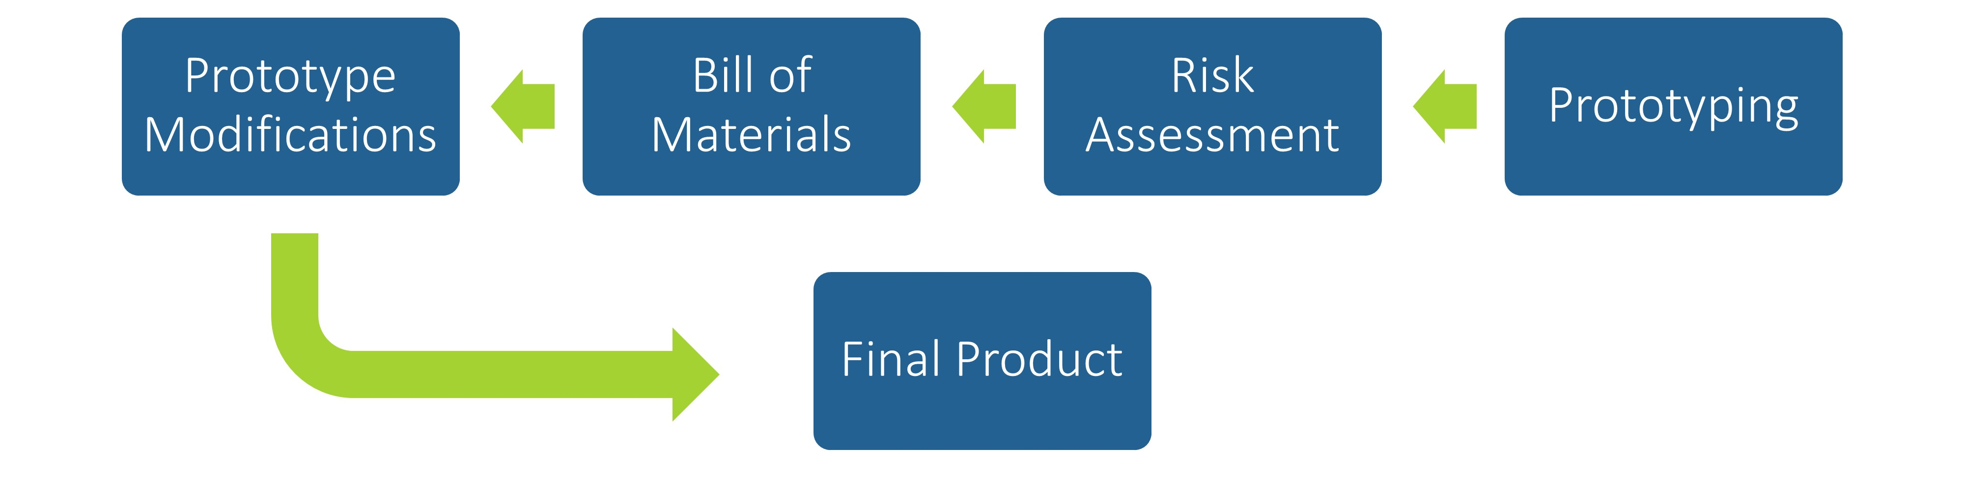
Future Work
Prosley Dorcely

Slide 27
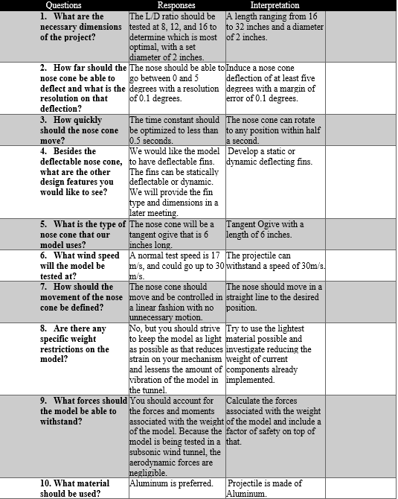
Customer Needs Backup

Slide 28
Markets Backup
Primary Market
  FCAAP (Florida Center for Advanced Aero Propulsion)
Secondary Markets
  Air Force Office of Scientific Research (AFOSR)
  Air Force Research Laboratory (AFRL)
  Lockheed Martin
  General Dynamics
  Raytheon Technologies
  Boeing
  Northrop Grumman

Slide 29
Stakeholders Backup
Florida Center for Advanced Aero Propulsion
FAMU-FSU College of Engineering
Dr. Rajan Kumar
Dr. Jonas Gustavsson
Dr. Shayne McConomy
Dr. Suvranu De

Slide 30
Standard Shapes
Summary Box
Text box 1
Outlined Text Box

Slide 31




Approved Logos

Slide 32
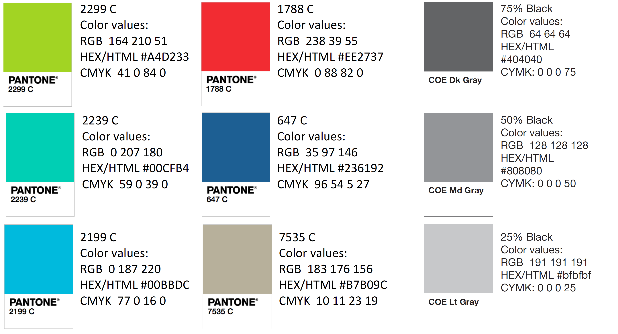
Color Palette

Slide 33
APA Tables
Category 1 | Category 2 | Category 3 | Category 4 | Category 5
Item 1
Item 2
Item 3
Item 4
 | Category 2 |  |  | Category 3
Category 1 | subcategory 1 | subcategory 2 |  | subcategory 1 | subcategory 2
Item 1
Item 2
Item 3
Item 4

